Slide 1



AutoRestTest
An AI-Powered Platform for Automated REST API Testing
Mohammad Ismail Hossain
BSSE 1433
Supervised by: Toukir Ahammed
1

Slide 2
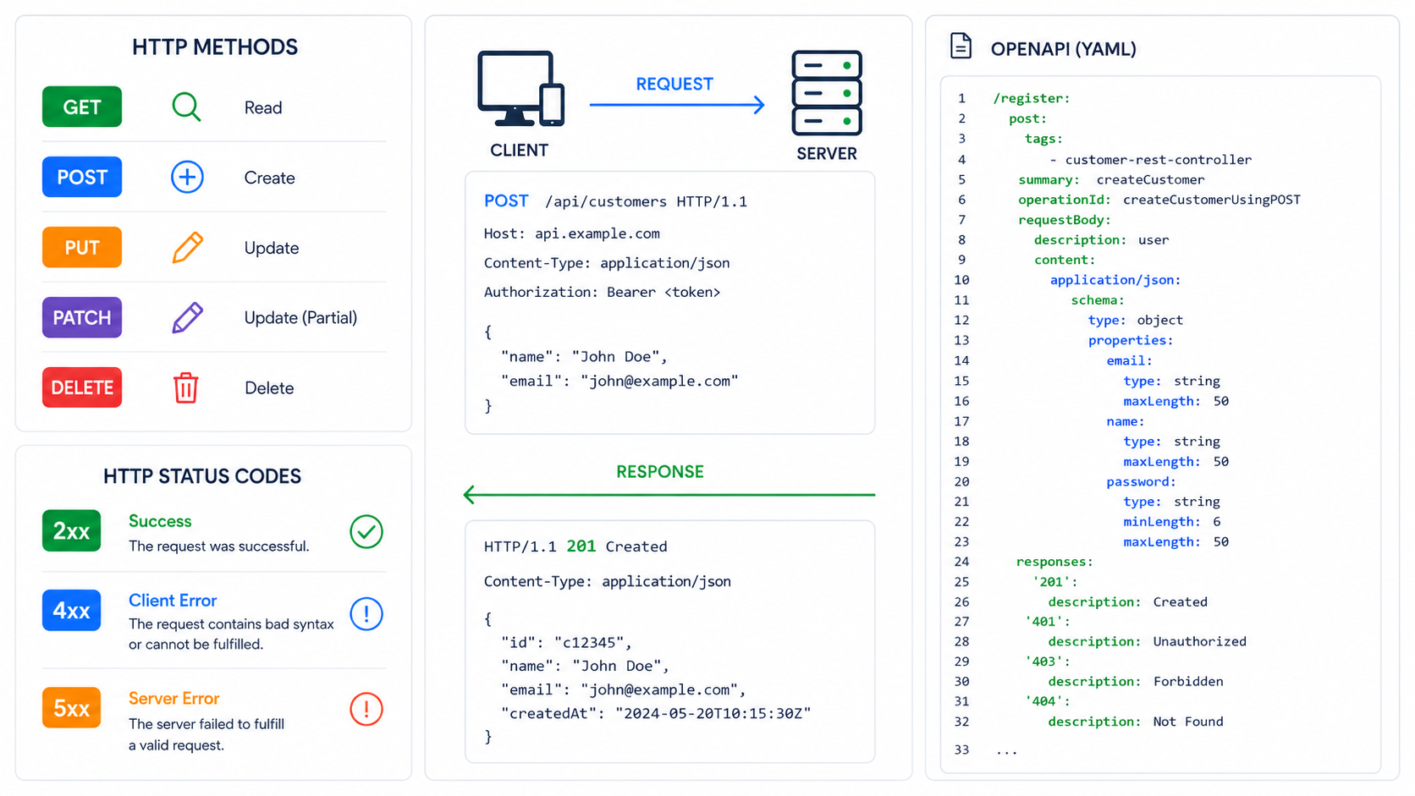
Background: REST API & OpenAPI
2

Slide 3
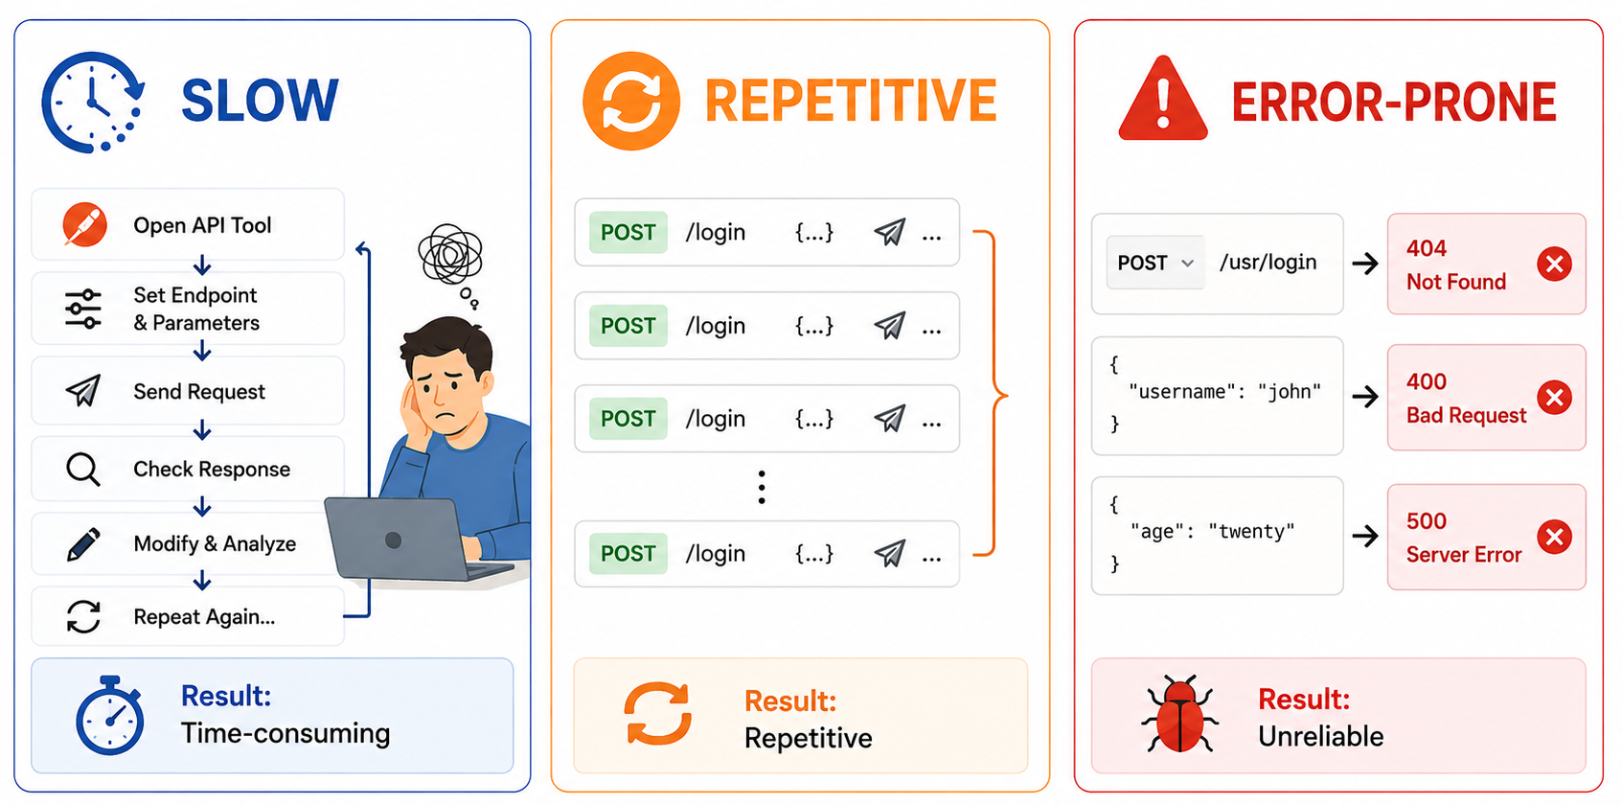
What's wrong with Manual testing?
3

Slide 4
AutoRestTest Approach
3 CORE MODULE
  Semantic Property Dependency Graph (SPDG)
  REST Agents
  Q Learning and Agent Policy
4

Slide 5
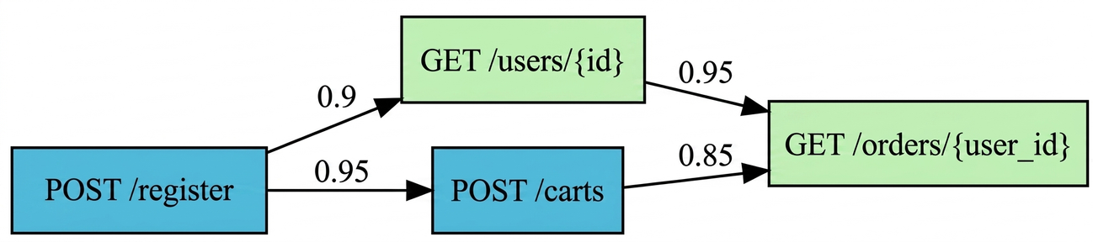
AutoRestTest Approach
SPDG
  Parse OAS & assign each API operation as a node
  Target: parameters, request body, response schema
  GloVe word-embedding model to compute semantic similarities
  semantic similarity score threshold 0.7
5

Slide 6
AutoRestTest Approach
REST AGENTS
Dependency
Operation
Parameter
Value
Header
Reuses values from prior successful requests
Rewarded for 2xx success response
Selects target endpoint, HTTP method from SPDG
Rewarded for 4xx,
5xx response
Selects combinations of query and body properties
Rewarded for 2xx success response
Selects data sources (Reuse vs. LLMs vs. Random)
Rewarded for 2xx response
Handles authentication tokens and metadata state.
Rewarded for 2xx response
6

Slide 7
AutoRestTest Approach
Q-Learning
  Q-table which initially set to 0 and updated by API responses
  epsilon-greedy strategy (ϵ - exploration, 1- ϵ exploitation)
  update Q-values using the Bellman Equation
  uses value decomposition as multiple agents work together
  operation agent rewarded for 4xx, 5xx and other agents rewarded for 2xx
7

Slide 8
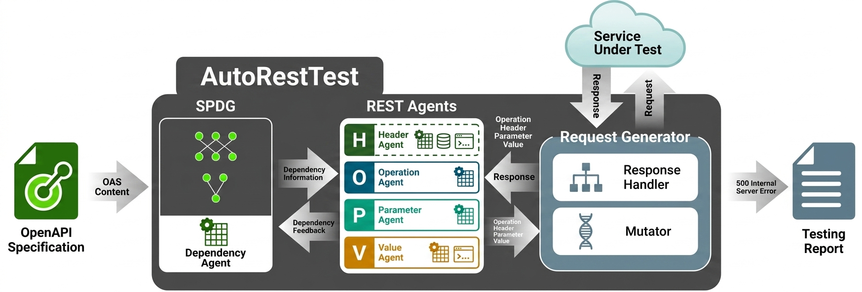
AutoRestTest Approach
8

Slide 9
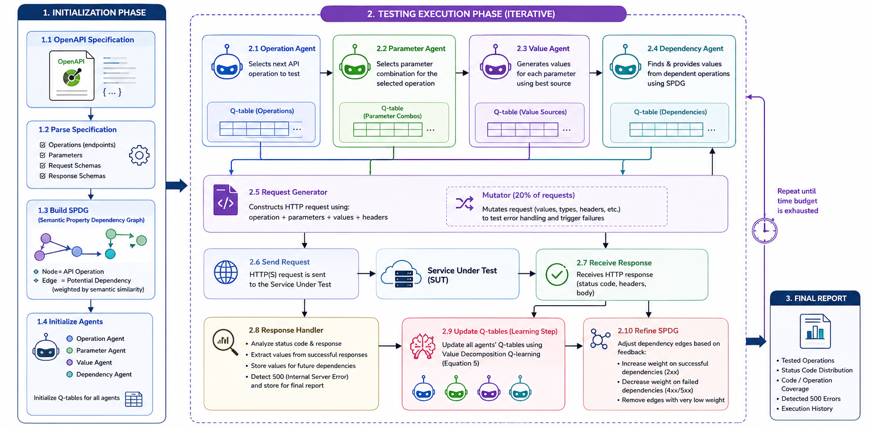
AutoRestTest Workflow
9

Slide 10
Project Features
  account creation
  multiple project manage
  test suits manage under project
  automatically generate OAS file from codebase
  one-click automated testing
  collaboration with team members
  dashboard to show test process
  detailed testing report
  test result tracking
10

Slide 11
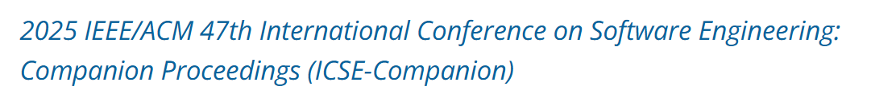
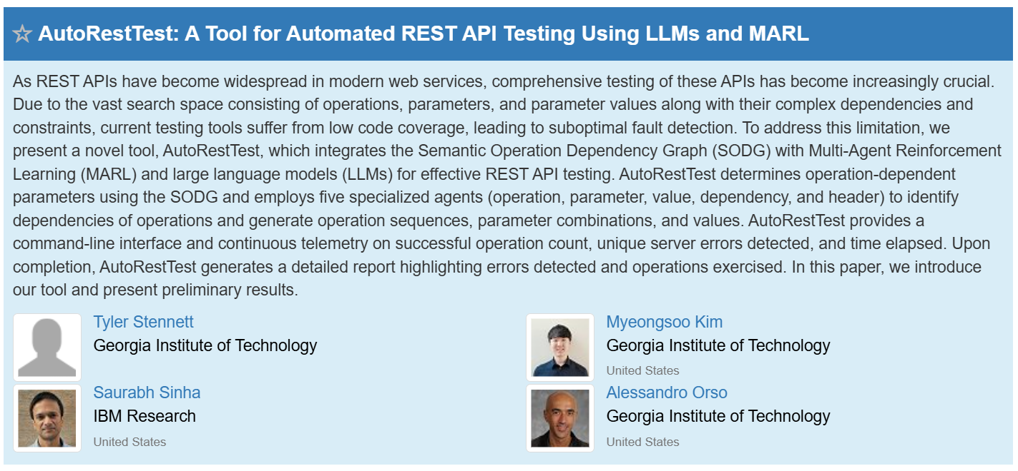
Motivating Paper
11

Slide 12


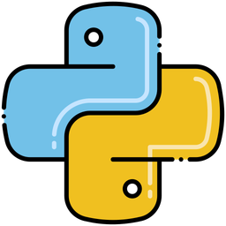









Tools
12

